Slide 1
Improved Method for Predicting β-turn Using Support Vector Machine
Bioinformatics Vol.21 no.10 2005, pages 2370-2374
Qidong Zhang, Sukjoon Yoon and William J. Welsh
Presenter: Jun-Shong Lin
Date: Nov. 2, 2006

Slide 2
Abstract
Motivation: Numerous methods for predicting β-turns in proteins have been developed based on various computational schemes. Here, we introduce a new method of β-turn prediction that uses the support vector machine (SVM) algorithm together with predicted secondary structure information. Various parameters from the SVM have been adjusted to achieve optimal prediction performance.

Slide 3
Abstract (Cont.)
Results: The SVM method achieved excellent performance as measured by the Matthews correlation coefficient (MCC = 0.45) using a 7-fold cross validation on a database of 426 non-homologous protein chains. To our best knowledge, this MCC value is the highest achieved so far for predicting β-turn. The overall prediction accuracy Q_{total} was 77.3%, which is the best among the existing prediction methods. Among its unique attractive features, the present SVM method avoids overtraining and compresses information and provides a predicted reliability index.

Slide 4
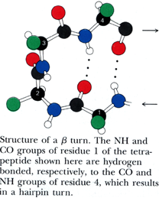
Introduction
β-turn is a particular type of tight turn that consists of four consecutive residues which are not within an α-helix. The distance between the first and fourth (the last) C_{α} is <7Å. On average, about 25% of all protein residues comprise β-turns.

Slide 5
Materials and Methods
Dataset:
426 non-homologous protein chains.
(No two protein chains have >25% identity.)
Design:
The SVMlight program was used to train the SVM classifier. The amino acid type of each residue is encoded into a length-20 vector.
Example:
Alanine (ALA): (1,0,0,0,0,0,0,0,0,0,0,0,0,0,0,0,0,0,0,0)
Null Residue : (0,0,0,0,0,0,0,0,0,0,0,0,0,0,0,0,0,0,0,0)

Slide 6
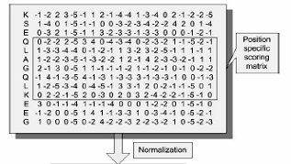

Materials and Methods
Design:
With multiple alignments, we use the position-specific scoring matrix generated by PSI-BLAST as input to our SVM classifier. These profiles were scaled to 0–1 range using the standard logistic function:
From PSIPRED is encoded as follows: helix → (1,0,0), strand → (0,1,0), coil → (0,0,1). The window size was set to 7-residues in accordance.

Slide 7
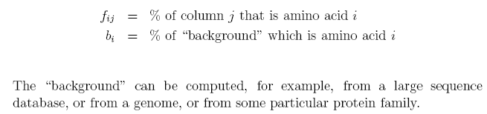




Materials and Methods
Position
Example:
1 2 3 4
1.
2.
3.
4.
L E V K
L D I R
L
V
D
L E I K
L D V E
………
Amino acid

Slide 8
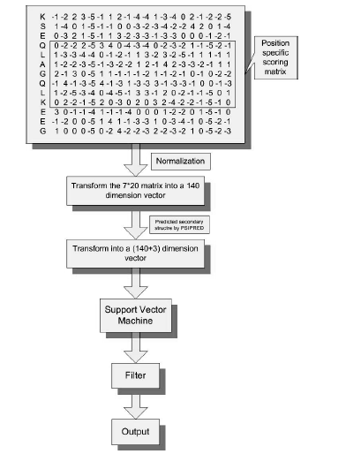
Materials and Methods

Slide 9

Materials and Methods
Training and Testing:
We employed 7-fold cross validation to evaluate the performance of the present method. The 426 protein chains were divided into 7 subsets of equal size (i.e. 6 subsets contained 61 chains; 1 subset contained 60 protein chains).
γ = 0.0186 , C = 16 .

Slide 10

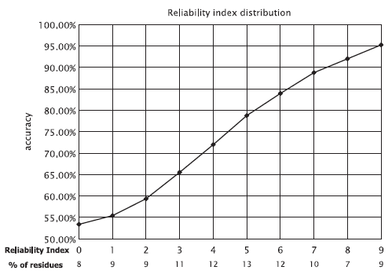
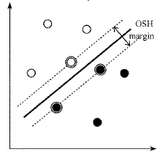
Materials and Methods
Reliability index:

Slide 11
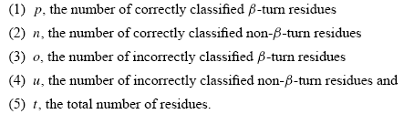



Materials and Methods
Performance measures:
Example:
t = 100 ,p = 0 ,n = 75 ,o = 0 ,u = 25.
Q_{total} = 75%
Q_{predicted} = 0%
Q_{observed} = 0%

Slide 12



Materials and Methods
Performance measures:
Example1:
t = 100 ,p = 25 ,n = 75 ,o = 0 ,u = 0.
MCC = 1
R = 62.5
S = 100%
Example2:
Example3:
t = 100 ,p = 20 ,n = 70 ,o = 5 ,u = 5.
t = 100 ,p = 25 ,n = 65 ,o = 0 ,u = 10.
MCC = 0.733…
R = 62.5
S = (90-62.5)/(100-62.5) = 74.02…%
MCC = 0.786…
R = 57.5
S = (90-57.5)/(100-57.5) = 76.47…%

Slide 13
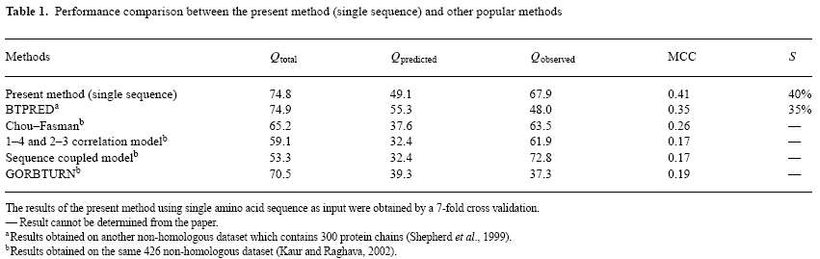
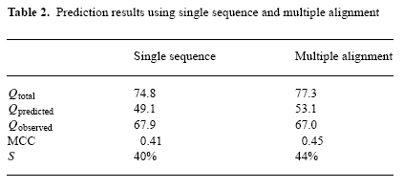
Results

Slide 14
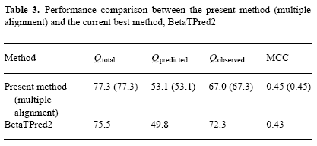
Results

